Slide 1

Payroll 101+
Armen Mnatsakanian
Terry Flexser
Christina Troung

Slide 2
Agenda
Credit Adjunct, Classified, Sick Leave, and Contact Information
Adjunct Payroll
  Check Stub Sample
  Salary Tables
  Retirement Options & EE Reduction vs ER Contribution
  Spring 2020 Payroll Pay Periods & Check Issue Dates
  16 Week Pay
    Credit + Non Credit
  Office Hours
    Credit + Non Credit
  Adjunct Increment List

Slide 3
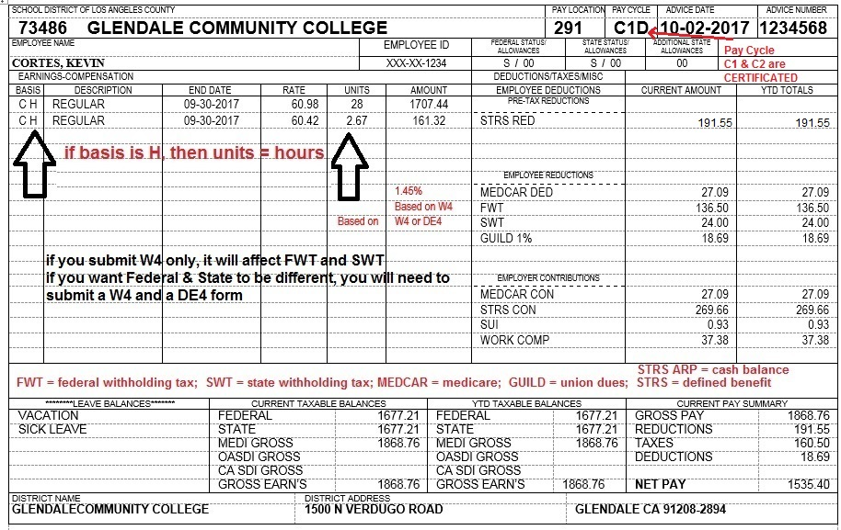

Slide 4
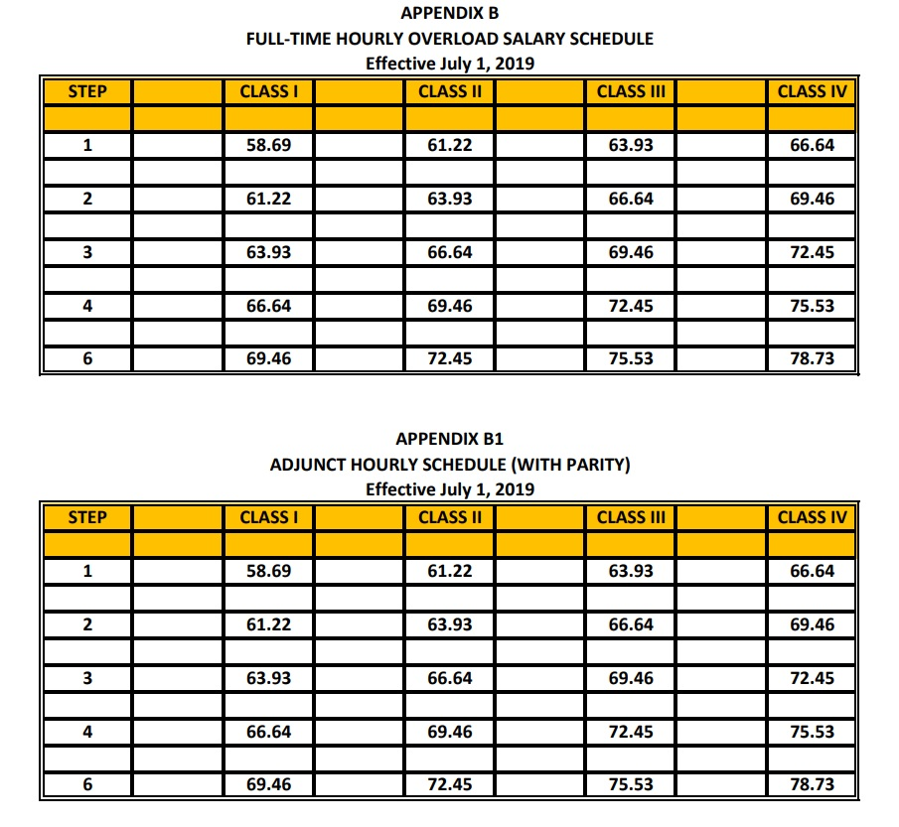
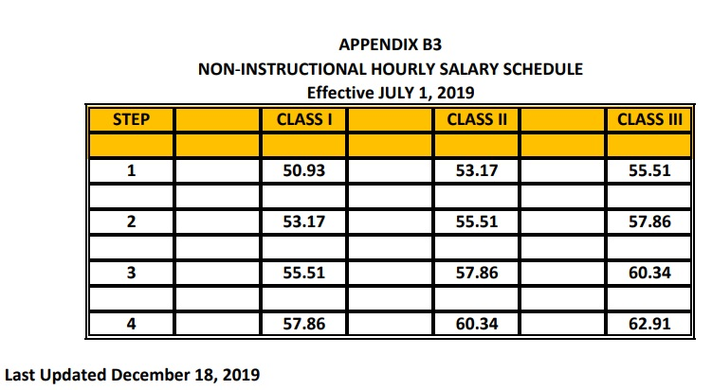

Salary Tables
Due to Guild negotiations, all teaching, office hours, substitute work, overload, etc are paid at the same rate based on schedule B1
*only difference is non instructional (B3)
For all salary schedules

Slide 5
Retirement Options
California State Teachers’ Retirement System (CalSTRS)
 | Employee pre tax reduction amount | Employer Contribution amount | Total
Cash Balance | 4.00% | 4.00% | 8.00%
Defined Benefit | 10.25% | 17.10% | 27.35%
For more detailed information regarding retirement, please contact CalSTRS directly.
https://www.calstrs.com/

Slide 6
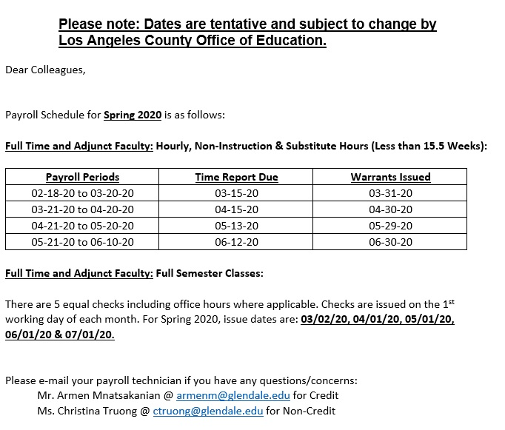
  Spring 2020 Payroll Pay Periods & Check Issue Dates

Slide 7
16 Week Pay – CREDIT
16 week pay which as also known as the “Flat Rate”
  5 equal checks over the semester; paid on 1st working day of month
  Ex. 3 unit class, flat rate
  3 x 17.5 weeks divided into 5 equal payments
  3x17.5 = 52.5 paid teaching hours over the semester
  52.5 / 5 equal checks = 10.5 hours paid per check
  If you have any discrepancy in pay, please contact your Division Chair first

Slide 8
Office Hours - CREDIT
Ex. 3 unit class, 15 FT teaching load for subject
Calculation approved by Guild:
3/15 = 0.2 0.2 x 5 = 1 hr office hour per week
For payment… 1 x 17.5 / 5 = 3.50 hours of paid office hour time per check
Total payment for a 3 unit flat rate class with a 15 FT load per check is:
10.50 hours teaching
3.50 hour office hour pay

Slide 9
16 Week Pay – NON CREDIT
16 week pay which as also known as the “Flat Rate”
  5 equal checks over the semester; paid on 1st working day of month
  Ex. 3 unit class, flat rate
  3 x 15.5 weeks divided into 5 equal payments
  3x15.5 = 46.5 paid teaching hours over the semester
  46.5 / 5 equal checks = 9.3 hours paid per check

Slide 10
Office Hours – NON CREDIT
3 unit class, 21 FT teaching load for subject
3/21 = 0.14 0.14 x 5 = 0.71 office hour per week
For payment… 0.71 x 15.5 / 5 = 2.20 paid office hour time per check
Total payment for a 3 unit flat rate class per check is:
9.30 hours teaching
2.20 hour office hour pay

Slide 11
Adjunct Increment List
Fiscal year July to June and includes 4 semesters (Summer, Fall, Winter, Spring)
  You can earn a maximum of 3 semesters worth of credit for advancement
Effective the beginning of… | Step
First semester | 1
5^{th creditable semester} | 2
9^{th creditable semester} | 3
13^{th creditable semester} | 4
21^{st creditable semester} | 6
Any questions regarding increment list, please contact Sara Lupo in Human Resources

Slide 12
Agenda
Classified Payroll
  Check Stub Sample
  PERS Contribution Changes
  Pay Days
    Changes to Direct Deposit

Slide 13
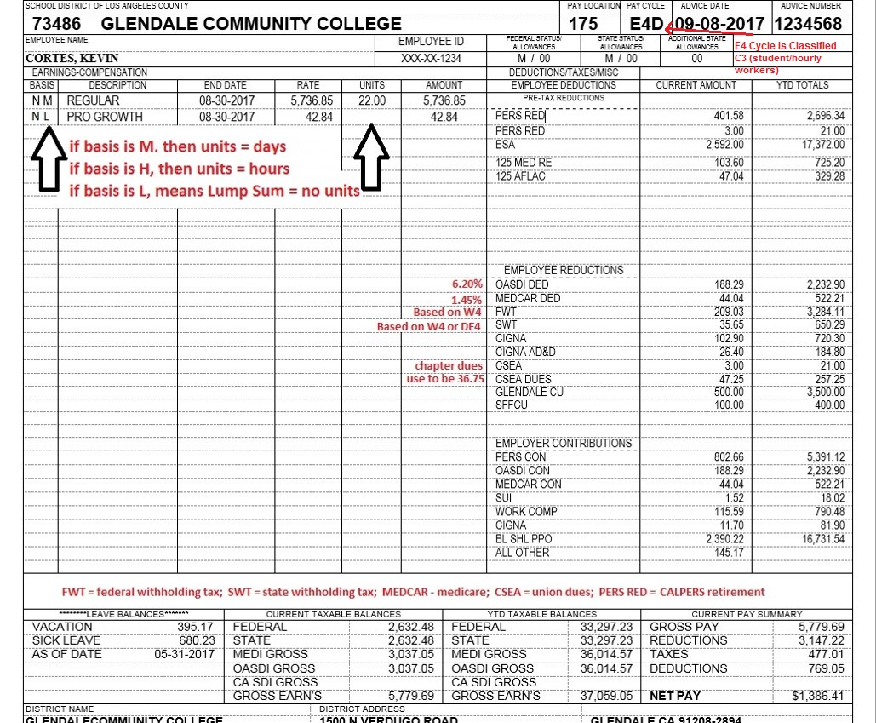

Slide 14
Changes to PERS Contributions
California Public Employee Retirement System (CalPERS)
Changes to 2018-2019 rates | Employee pre tax reduction amount | Employer Contribution amount | Total
Classic (Pre January 2013) | 7.00% | 19.721% (increase from 18.062%) | 26.721%
PEPRA (Post January 2013) | 7.00% (increase from 6.5%) | 19.721% | 26.721%
https://www.calpers.ca.gov

Slide 15
Bi-Monthly Pay
Pay is always on the 10th and 25th of each month unless it falls on a weekend or Holiday
  If so, payday is the previous workday
Direct Deposits
  Pay will be deposited the day of payday including Credit Unions
  If closing direct deposit account, please notify Payroll before doing so

Slide 16
Agenda
Sick Leave Accounting
  Personal Necessity
  Looking up your balances
  Sick Leave / Vacation
    Reports

Slide 17
Personal Necessity
When PN is used, hours are taken from sick leave as well as PN balances
  Example picture to follow
PN DO NOT carry-over

Slide 18
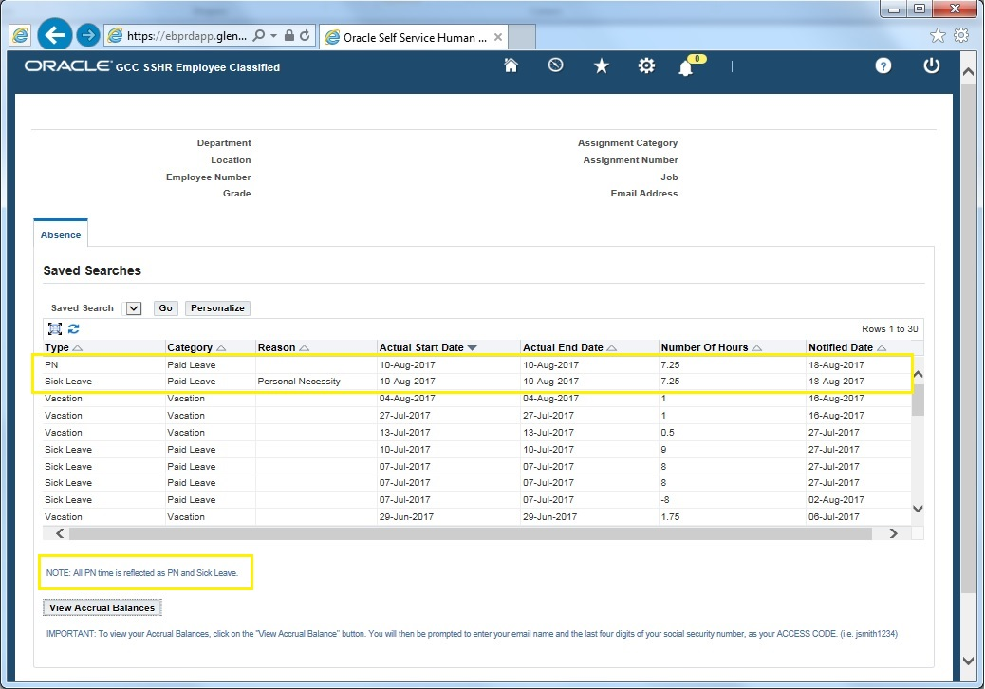
PN Absences create two Entries

Slide 19
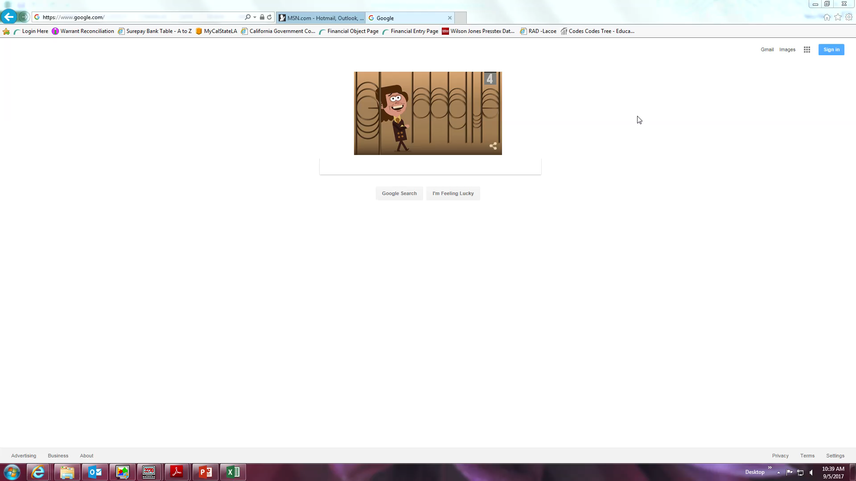
How To Look Up Balances

Slide 20
Sick Leave/Vacation
Balances are carried over around September of the next year
Sick leave never gets taken away
Vacation has a MAXIMUM LIMIT that can be carried over
Absence Reports
Reports are due EVERY WEEK (the following Tuesday) to Payroll
Any changes/corrections must come with an Admin. Signature
If there are no absences, please still turn one in stating NONE

Slide 21
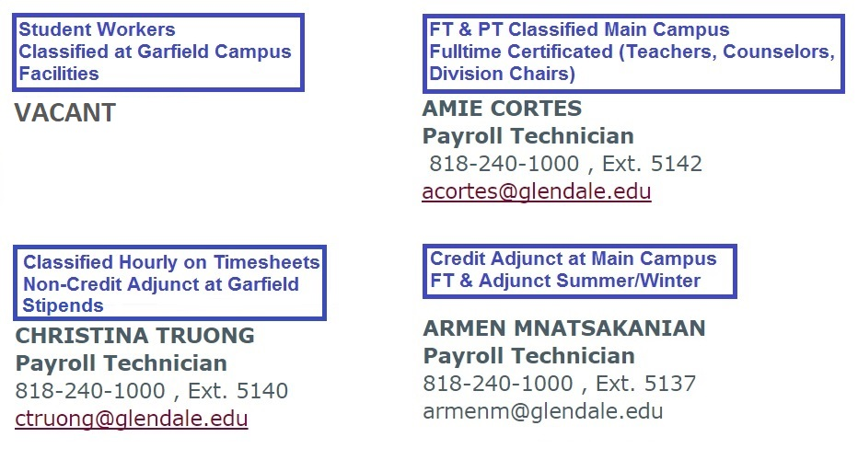
Contact Information

